Slide 1

BUILDING AN EVALUATION FRAMEWORK AND BUILDING AN EVALUATION CULTURE
Carina Calzoni
(Clear Horizon WA)
Australasian Evaluation Society Conference 2011

Slide 2
Evaluation Culture Definitions
An Culture of Evaluation is where evaluation is embedded in an organisation and there is ‘a commitment to roles for evaluation in decision-making within an organisation’ (Owen 2003)
An indicator of an evaluation culture:
  Where evaluation is valued for its process use as well as its instrumental use
    Process use is defined as “the changes in thinking and behaving that occur among those involved in the evaluation as a result of the evaluation process.” (Patton 2002)

Slide 3
How do you create an evaluation culture?
Owen (2003) describes the development of an evaluation culture as ‘the introduction of a major process innovation, and a significant organisational change.’
A case study of developing an evaluation culture:
The process innovation is the development and introduction of an evaluation framework
Evaluation capacity building strategies are vital to the organisation change

Slide 4

Royalties for Regions Program
A regional development funding program where the equivalent of 25 per cent of the State’s mining royalties are returned to WA’s regional communities in addition to the regular budget allocation
In its 4th year. In 2009-10 it provided an additional $619 million to regional communities
It is managed by Dept. of Regional Development and Lands WA
The Program has a high profile, is political and is under considerable public scrutiny

Slide 5
Need for a strategic evaluation approach
Since the inception of the program 2 evaluations had been completed. They were not strategic choices and their use was limited
The Evaluation Team was newly formed and not well resourced or skilled in program evaluation
The division recognised the need for a comprehensive evaluation framework and for evaluation capacity building

Slide 6
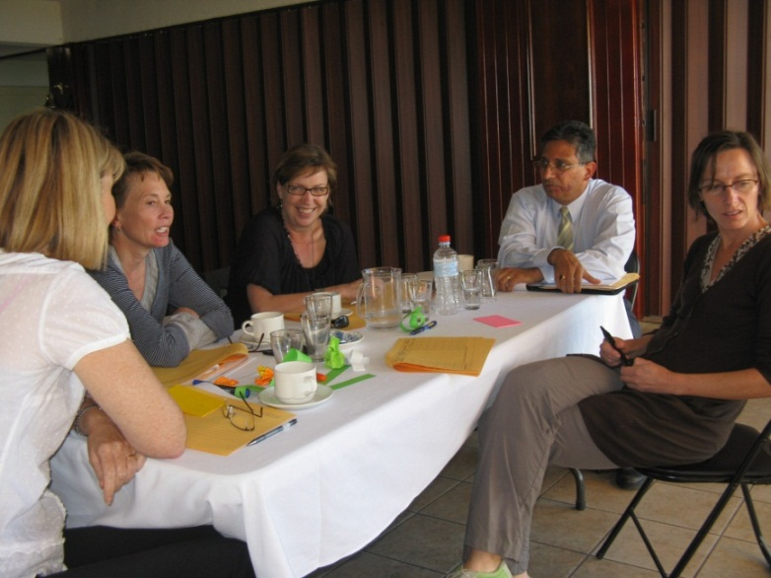
The evaluation building approach - Planning
Objectives:
Build the evaluation capacity of the key staff
Internally design and implement an Evaluation Framework for the Royalties for Regions program
Contract an outsider evaluator to train and mentor staff in program evaluation

Slide 7
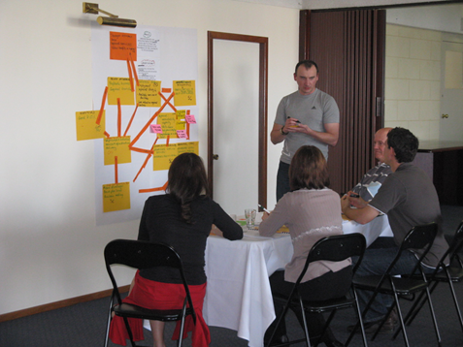
The evaluation building approach Implementation
Evaluation Capacity Building
4 one day workshops over 6 weeks – program logic, evaluation audience, developing KEQs, choosing appropriate methods, reporting/communicating evaluation findings, and managing evaluation studies
Provided materials – templates, workbook, workshop notes and references
Provided mentoring

Slide 8
The evaluation building approach Implementation
Evaluation strategies, policies and processes
Evaluation Framework was developed and signed off by the executive
Have developed a clear and transparent prioritisation and selection process
Developed an evaluation scoping template
About to put out a request for tender for first evaluation

Slide 9
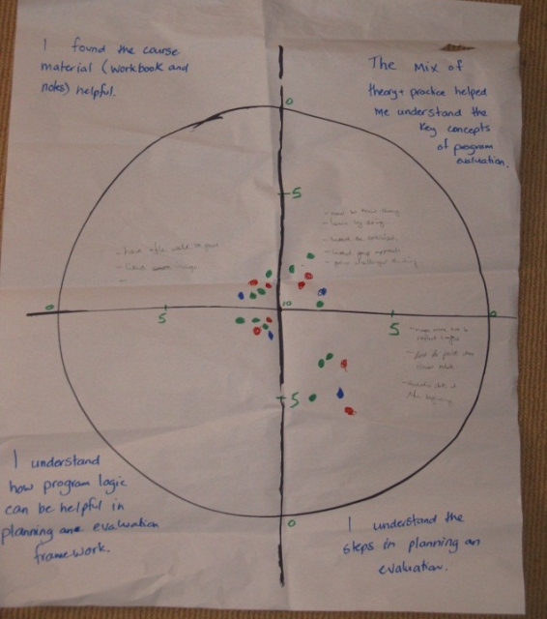
The evaluation building approach Evaluation
Evaluation at the end of the 4 session workshop
SSI with all members of the Evaluation Team (6 months later)
“The course gave me an understanding of evaluation – that understanding has helped me to teach others.”
“We are using the language in the team and we know what we are talking about.”
“Fear that evaluation being done for the wrong reasons (as a marketing exercise) with not good intent.”

Slide 10
Findings
The training helped to build understanding of evaluation
Projects are starting to be designed better
Measures (KPI) are being linked to outcomes
Language of evaluation is spreading
BUT
Perception is that evaluation is not supported by the leaders and will not be adequately resourced
The motivations for evaluation are not clear (accountability, learning?)
Evaluation knowledge is not being fully transferred into evaluation practice

Slide 11
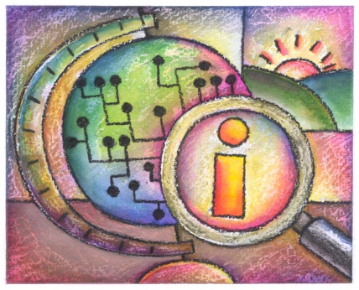
Reflections and learning
Multidisciplinary Model of Evaluation Capacity Building (Preskill & Boyle, 2008) - provides a framework for designing and implementing evaluation capacity building initiatives
The model provides strategies and concepts based around 2 themes;
Evaluation knowledge, skills and attitudes (evaluation capacity building)
Systems, processes, policies and plans that embed evaluation within an organisation (sustainable evaluation practice)

Slide 12
Evaluation Capacity Building What we did
Design
ECB strategies
Training
coaching
Manual
Written materials
Evaluate
implement

Slide 13
What’s missing?
Design
Assumptions
Motivations
ECB strategies
Training
coaching
Manual
Written materials
Evaluate
implement
Expectations

Slide 14
Sustainable Evaluation Practice
What’s now in place
Evaluation policy
Evaluation framework
Strategic plan for evaluation
Shared evaluation beliefs
Use of findings
Resources
Continuous Learning

Slide 15
What’s missing?
Evaluation policy
Evaluation framework
Strategic plan for evaluation
Shared evaluation beliefs
Use of findings
Resources
Continuous Learning

Slide 16
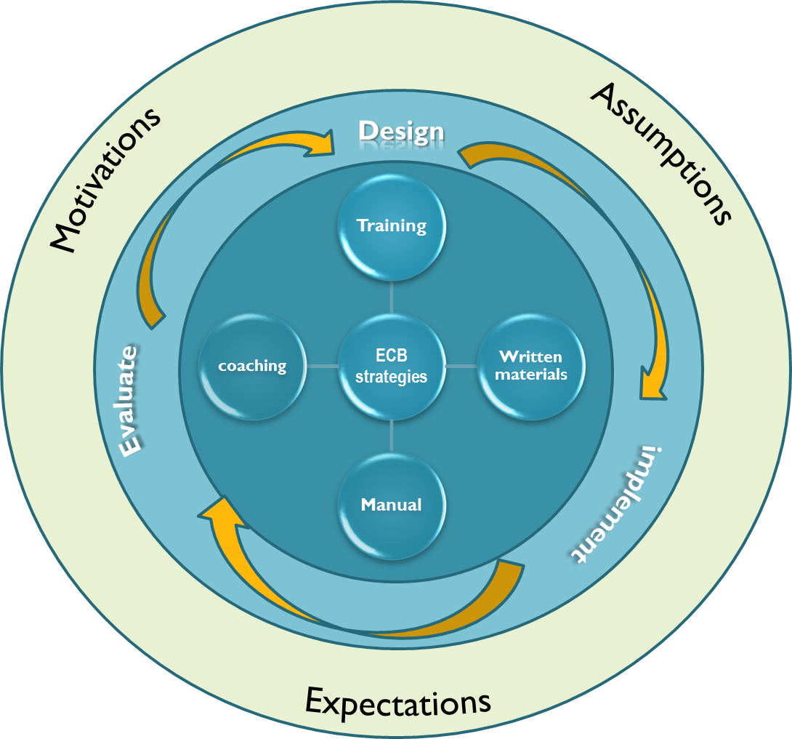
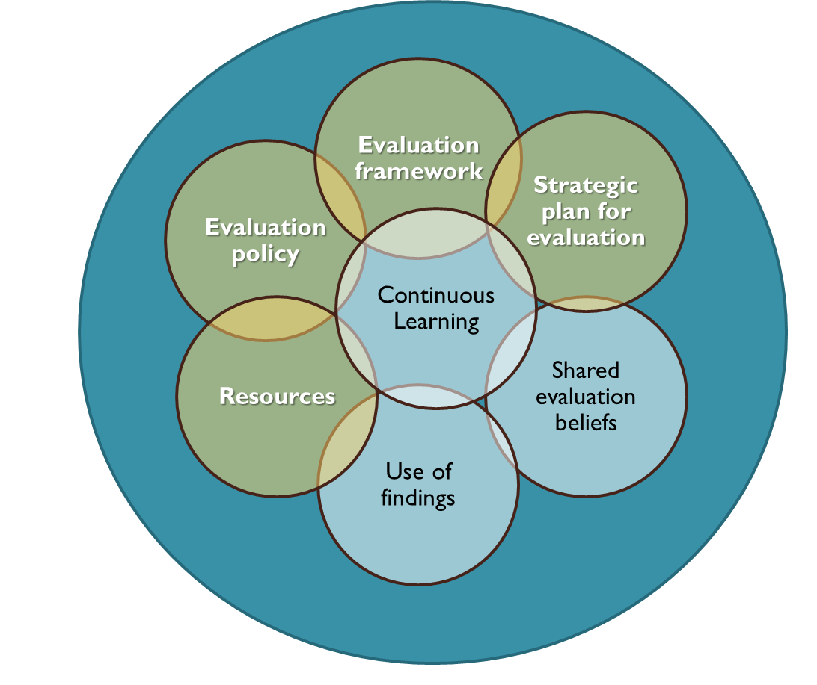
A vision for an evaluation culture
Evaluation Knowledge, Skills and Attitude
Sustainable Evaluation Practice
Transfer of Learning
(modified from Preskill & Boyle 2008)

Slide 17
Conclusion
- The early signs of an evaluation culture now exist within the Evaluation team
- The challenge is to extend it and make it sustainable
Next steps – Towards the vision
Address the motivations, assumptions and expectations in the next planning phase of ECB
Further develop the organisational systems and processes that support and embed evaluation practice
Put strategies in place to support and evaluate the transfer of learning – e.g. how is the evaluation knowledge being applied?
Communication about evaluation

Slide 18
references
Owen, J. M. (2003) Evaluation culture: a definition and analysis of its development within organisations, Evaluation Journal of Australasia 3(1): 43-47
Patton, M. Q. (2002) Qualitative research and evaluation methods, 3rd edn, Sage Publishing Thousand Oaks CA, pp 189.
Preskill, H. and Boyle, S. (2008) A Multidisciplinary Model of Evaluation Capacity Building, American Journal of Evaluation, 29(4):443

